Slide 1
Computer Organization and Architecture – Let’s solve these.
Shriram K Vasudevan
Session – 15

Slide 2
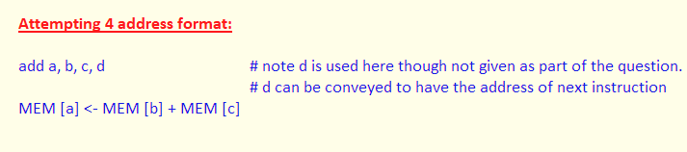
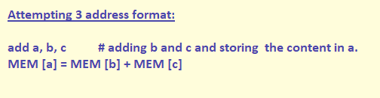
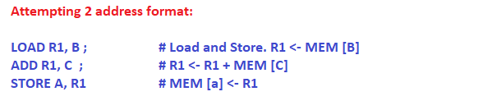
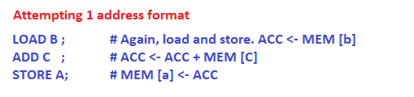
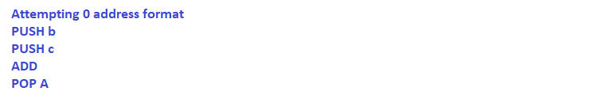
Q.No. 1
Write the following expression using 4 address format, 3address format, 2 address format,1 address format and 0 address format. a = b + c ; # this is the question folks.

Slide 3
You work this out!
Write the following expression using 4 address format, 3address format, 2 address format,1 address format and 0 address format x=(y+d)/(d+3)
You folks try this and get me answer.

Slide 4
Q.NO. 2
Give the register transfer notations for the following MIPS Instructions. (It could be asked as RTN or RTL also)
LW $t2,100($s2) $t2<-mem[100+$s2]
SW $t3,32($s2) mem[32+$s2]<-$t3
beq $t1,$t3,8 if $t1==$t3 goto (pc+4)+8
addi $t1,$t2,32 $t1<-$t2+32

Slide 5
Q.NO. 3
For the following MIPS INSTRUCTIONS give the RTL equivalents, addressing modes.
or $s2,$t1,$t2 $s2<-$t1 OR $t2 - Register addressing mode
sw $t3,12($t0) mem[12+$t0]<- $t3 - Base/displacement addressing

Slide 6
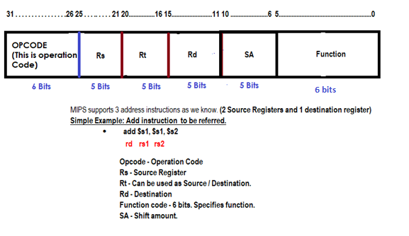
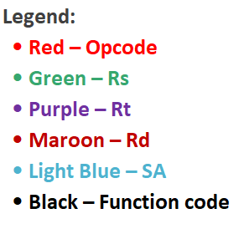
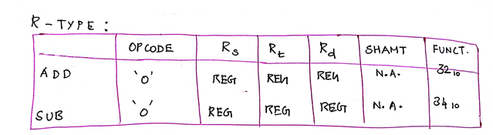
Q.NO. 4
registers $s0 to $s7 map onto registers 16 to 23, and registers $t0 to $t7 map onto registers 8 to 15.
Decode the instruction (010f8020)₁₆
0000 0001 0000 1111 1000 0000 0010 0000 = 32 bits (Length)
Let us decode:
0000 0001 0000 1111 1000 0000 0010 0000
Ans: add $16, $8, $15 == add $s0, $t0, $t7

Slide 7
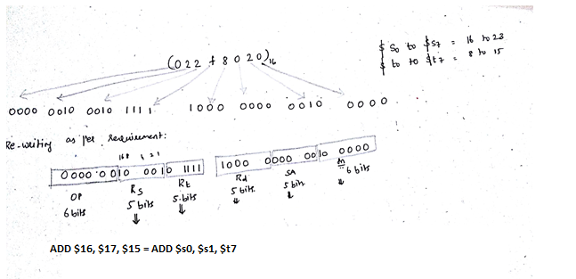
Q. NO. 5
registers $s0 to $s7 map onto registers 16 to 23, and registers $t0 to $t7 map onto registers 8 to 15.
Decode it yourself.
Decode the instruction (022f8020) ₁₆

Slide 8
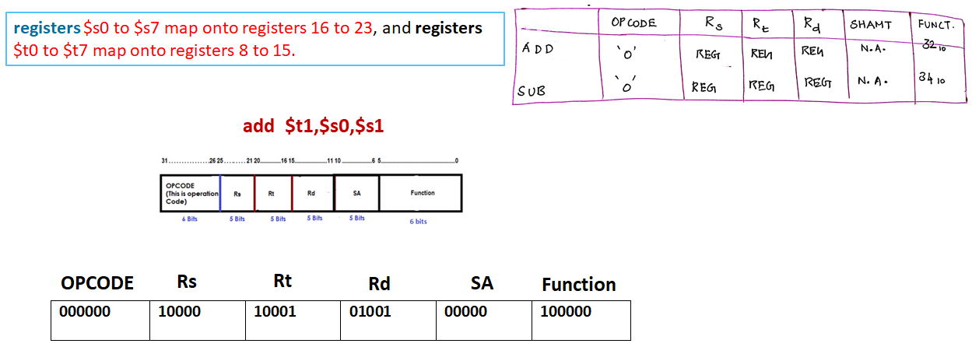
Q. NO. 6
Encode the following instructions in binary. Also write the RTL for each instruction
add $t1,$s0,$s1
$t1<-$s0+$s1

Slide 9
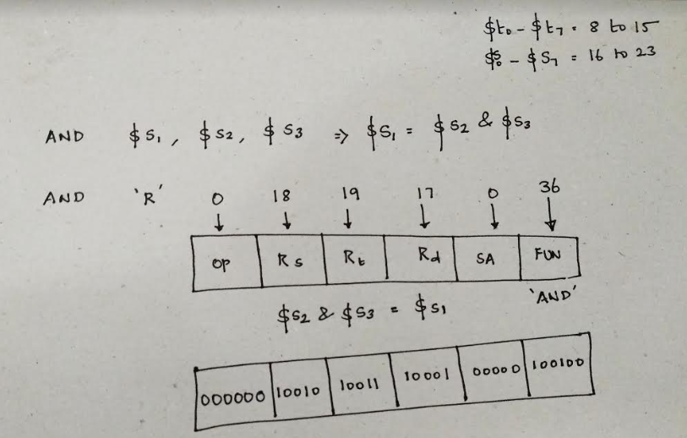
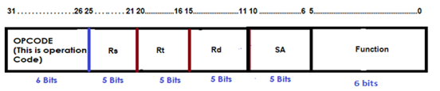
Q. NO. 7
Encode the following instructions in binary. Also write the RTL for the instruction presented.
and $s1,$t1,$t2 RTL : $s1 <-reg $t1 & reg $t2

Slide 10
Q.No.8
Mention the status of control signals for the below operation
ADD $s1, $s2, $s3
RegDst | ALUSrc | Memto Reg | Reg Write | Mem Read | Mem Write | Branch | ALUOP1 | ALUOP2
1 | 0 | 0 | 1 | 0 | 0 | 0 | 1 | 0

Slide 11
Q.No. 9
Mention the status of the control signals for the below instruction
LW $t0, 32($t1)
RegDst | ALUSrc | Memto Reg | Reg Write | Mem Read | Mem Write | Branch | ALUOP1 | ALUOP2
0 | 1 | 1 | 1 | 1 | 0 | 0 | 0 | 0
For you to solve!
Find the status of control signals for any SW operation.

Slide 12
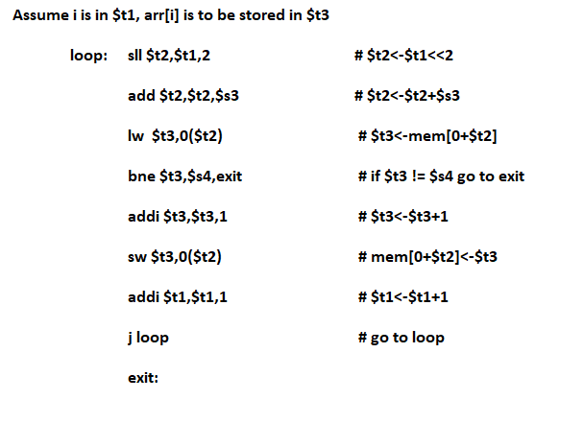
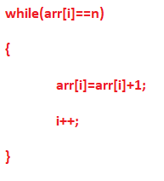
Q. No. 10
Write the MIPS equivalent for the following C Code.

Slide 13
Q. NO. 10
You work this out.
Write the MIPS equivalent for the following C Code.
1. a=(b-d)+2;
2. while(a!=b)
{
c=c+a;
a++;
}

